Slide 1
Fifty Years in Nursing: A Personal Reflection Susan A LaRocco PhD MBA RN FNAP
The Hope Conference
September 20, 2023

Slide 2
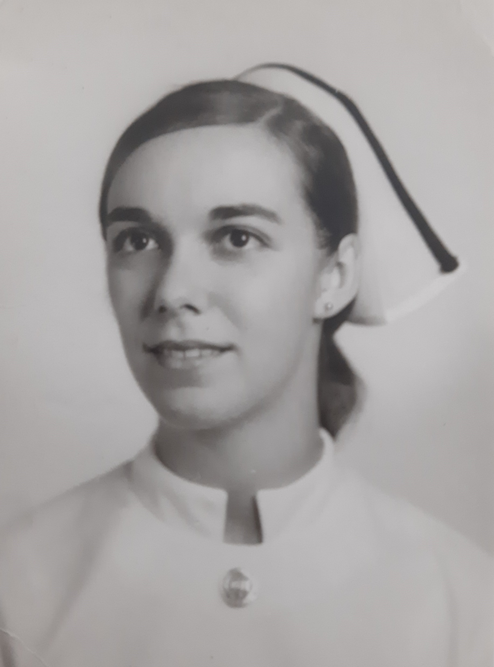
Nursing Class of 1972
95th commencement of the Buffalo General Hospital School of Nursing
60 women and 1 man
First man to graduate since 1967
The nursing school closed in 1987
Speaker: Dr Blackman
"The Changing Role of the Nurse in Health Care Today"

Slide 3
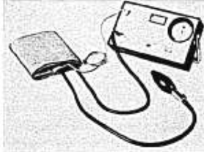
What’s New in 1972 (American Journal of Nursing )
Equipment
Electronic Sphygmomanometer
Books of the Year The Quality of Mercy: A Report on the Critical Condition of Hospital and Medical Care in America by Selig Greenberg
News Item
Nursing Students Sponsor their First Conference on Legislation

Slide 4
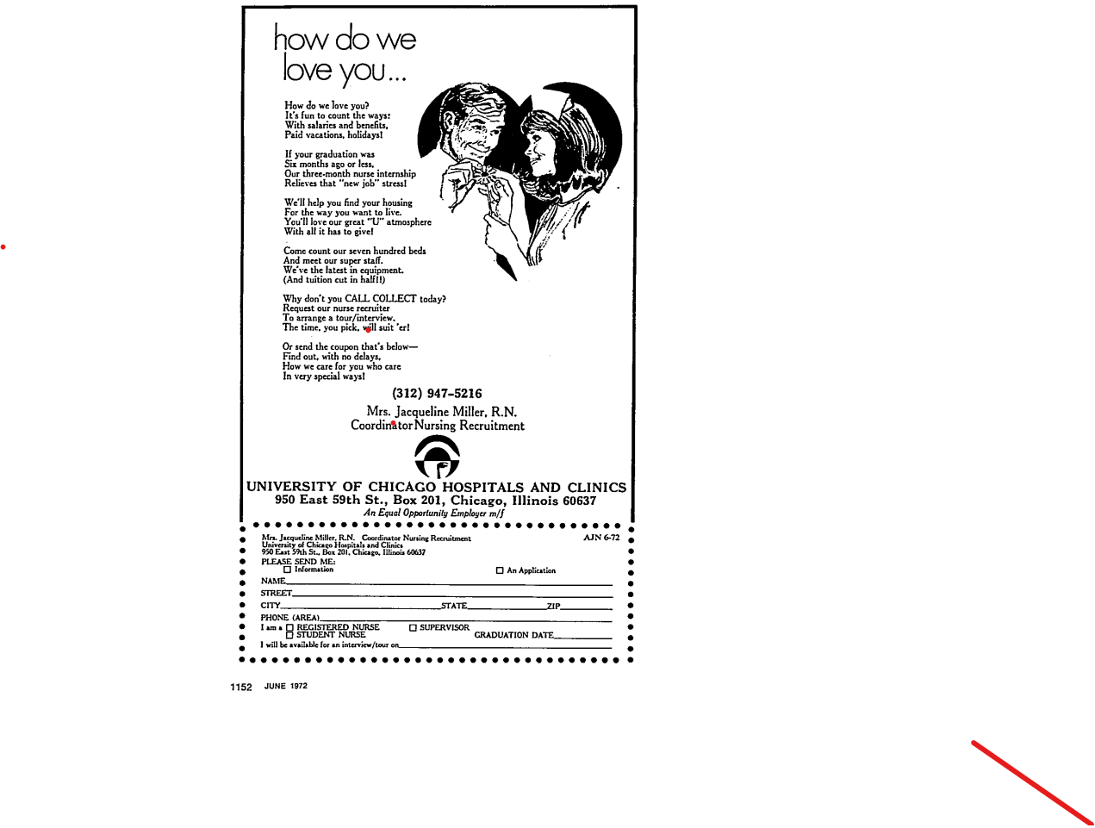
Nurse Recruitment (circa 1972)

Slide 5
ANA Position on Nursing Education
American Nurses Association’s First Position on Education for Nursing, published in December 1965
“Education for those who work in nursing should take place in institutions of learning within the general system of education”
“…minimum preparation for beginning technical nursing practice at the present time should be associate degree education in nursing”
“…minimum preparation for beginning professional nursing practice at the present time should be baccalaureate degree education in nursing”

Slide 6
Nursing Education
Hospital Based Schools of Nursing
many closed in the 1980s
1 in Massachusetts in 2023
Associate Degree Programs
started in 1952
proliferation in the 1970s
19 in Massachusetts in 2023
Baccalaureate Degree Programs
first prelicensure program in Massachusetts at Boston University (1948; closed in 1988)
25 in Massachusetts in 2023
Direct Entry Master's Degree Programs
7 in Massachusetts in 2023

Slide 7
Nursing Education
RN to BS Programs
Online
Hybrid
In person
Accelerated Second Degree Programs
Rapid growth in programs in the early 2000s
2022 NCLEX Test Takers
Diploma: 2,195
BS: 98,942
AS: 85,750
Other: 1,118
Boston College Tuition
1975-76 2023-24
$2,800 $64,176

Slide 8
Nursing Demographics
 | 1972 employed N = 794,979 | 2018 employed N = 3,245,080
Median age of employed nurses | 39 | 45.6
Highest education of employed nurses (1972) or all nurses (2018) | MS 2.3% BS 12.3% Diploma 76% AS 5.4% | MS 13.9% BS 44.6% Diploma 6.4% AS 29.6%
Male | 1.4% | 10%
Race | White 91% | White 73%

Slide 9
Licensure
1972 State Board Test Pool Examination
"the boards"
two days of exams; five sections
1982 National Council Licensure Exam (NCLEX)
1994 Computer Adaptive Testing (CAT)
more than 6 million have taken CAT
first health care organization to use CAT for licensure
1999 Licensure Compact started
now 41 states participate

Slide 10
The Practice Environment
1980s Three Influential Books
Magnet Hospitals: Attraction and Retention of Professional Nurses published by the American Academy of Nursing (1983)
Shared Governance for Nursing: A Creative Approach to Professional Accountability by O’Grady and Finnigan (1984)
From Novice to Expert by Patricia Benner (1984)

Slide 11
The Practice Environment
1990s
Magnet Hospital Program
ANA approved the Magnet Hospital Recognition Program for Excellence in Nursing Services (1990)
First hospital received Magnet status – University of Washington Medical Center (1997)
Today – 590 Magnet Hospitals
American Nurses Credentialing Center incorporated
17 certifications available (4 are for nurse practitioners)

Slide 12
The Practice Environment
2000s
To Err is Human (2000)
Systems focus
Just culture
Learning from errors
The Future of Nursing: Leading Change, Advancing Health (2011)
Practice to the full extent of education and training
Full partners, with physicians and other healthcare professionals, in redesigning health care

Slide 13
Patient Care
Length of Stay
1979: 9.7 days
2018: 5.5 days
Pre-op admissions
1970s – Everyone!
Now – Rare
Same day surgery

Slide 14
Professional Relationships
Shared Governance
Teamwork
Interprofessional Practice

Slide 15
New Diseases
1980s
HIV/AIDS
Universal precautions
1999 Needlestick Safety and Prevention Act
Needle boxes and gloves in every room
2020s
Covid

Slide 16
New Ways of Testing and Treating
A Revolution in Diabetes Management
Point of Care Testing – Glucometer
Prior to 1980s – urine dipstick; matched to color chart
First tried in 1970s – poor accuracy
1980 – the Dextrometer was launched; digital display
2004 – first effective real time continuous glucose monitoring
2006 – first integrated insulin pump and sensor
Growth in hemodialysis
1972 Federal reimbursement for dialysis care for ESRD
2018 more than 550,000 people receiving hemodialysis

Slide 17
New Words and Concepts
Quality and Safety
Time Out
Huddle
Evidence Based Practice
Same Day Surgery
Teamwork
SBAR
Nursing Theory
Unit Dose
Pixus/Omnicell
High Fidelity Simulation

Slide 18
What's The Same?
The passion for caring
Tired feet
Cyclical nursing shortages

Slide 19
Gone ... and Not Missed
White uniforms, stockings and caps
Reusable suction catheters
Mercury thermometers
Counting narcotics
IM injections for pain medication
Overhead paging in hospitals
Paper charts
Gone and missed?
PM care

Slide 20
Can You Believe?
Patients and staff smoked in the hospital
Cataract patients were on bedrest with sandbags next to their head to prevent movement
TPN run without a pump
Open wards with 15 to 30 patients

Slide 21
Today's Concerns
Workplace safety
Emerging infectious diseases
Nurse (and other health care workers) burnout
Entry into practice
Full practice authority for advanced practice nurses
Shortage of nursing faculty
Cultural humility/cultural competence
Workforce diversity

Slide 22
What Will the Future Bring?
Entry into practice at the baccalaureate level for RNs
Full practice authority for all advanced practice nurses in all states
Safer workplace
What changes would you like to see in the next 50 years?

Slide 23
References available on request
slarocco0603@curry.edu

